Slide 1
Sorting Algorithm
Data structure and Simulation flow

Slide 2
Sorting algorithms
7 Sets of Sorting Algorithm
Quick Sort
Merge Sort
Heap Sort
Bubble Sort
Insertion Sort
Selection Sort
Radix Sort

Slide 3
Simulation Data
3 Data Sets
Alphabet
100 random characters (pure alphabet)
Item Name has unique set of data-points
Category has incremental duplicated set of data-points
Brand has fixed 10x duplicated set of data-points
Data-points have 100K, 50K, 10K, 5K, 1K records
Alpha Numeric
100 random characters ( combinations of alphabet & numbers )
Item Name has unique set of data-points
Category has incremental duplicated set of data-points
Brand has fixed 10x duplicated set of data-points
Data-points have 100K, 50K, 10K, 5K, 1K records
Numeric
10-digits (from 1000000000 to max int of 2,147,483,647 )
Item Name has unique set of data-points
Category has incremental duplicated set of data-points
Brand has fixed 10x duplicated set of data-points
Data-points have 100K, 50K, 10K, 5K, 1K records

Slide 4
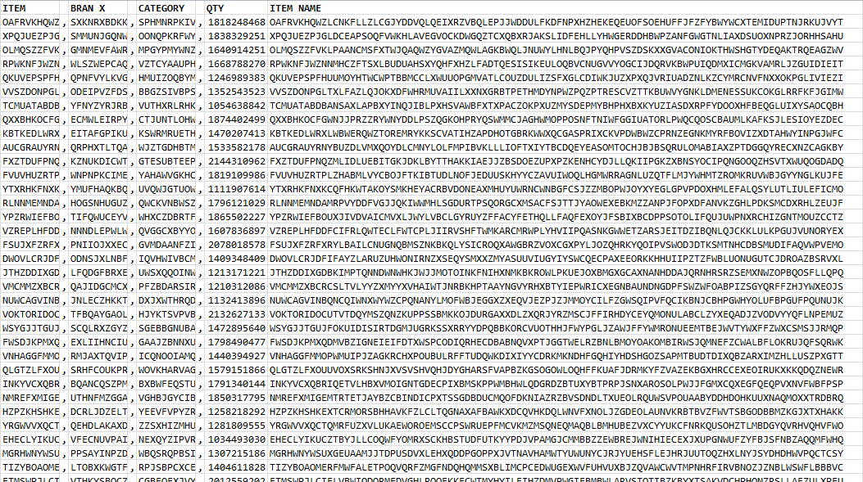
Simulation Data
Alphabet Data Set: ITEM NAME – Unique data-points

Slide 5
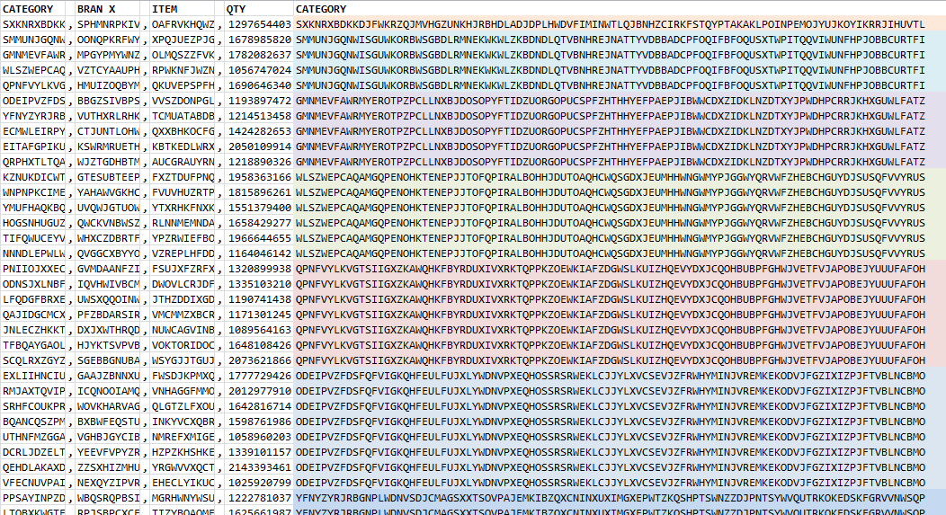
Simulation Data
Alphabet Data Set: CATEGORY – Incrementally duplicated data-points

Slide 6
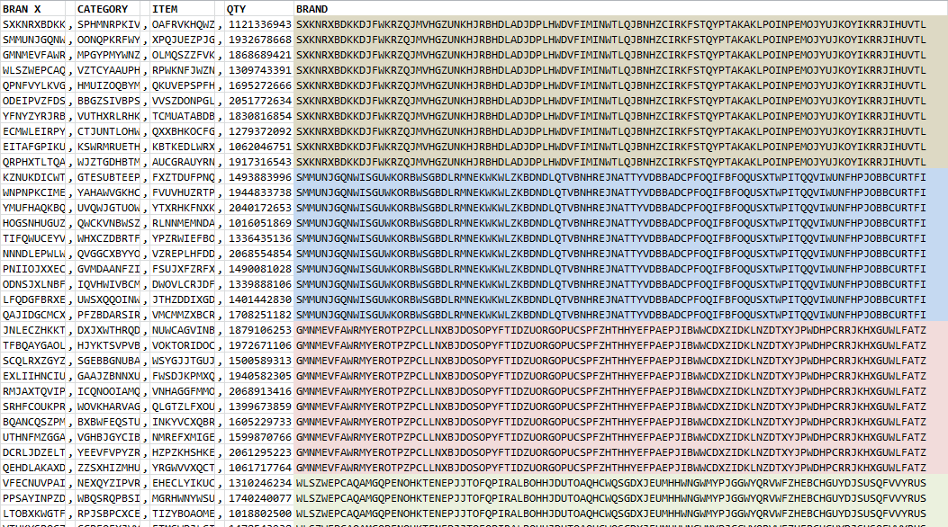
Simulation Data
Alphabet Data Set: BRAND – Fixed 10x Duplicated data-points

Slide 7
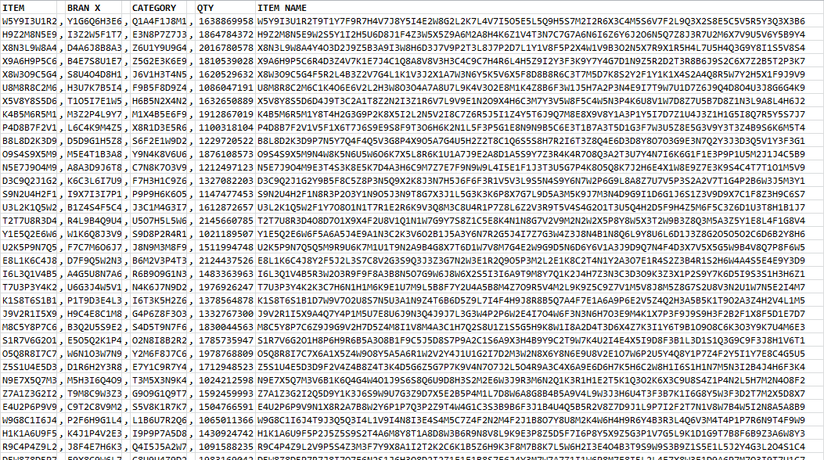
Simulation Data
Alpha-Numeric Data Set: ITEM NAME – Unique data-points

Slide 8
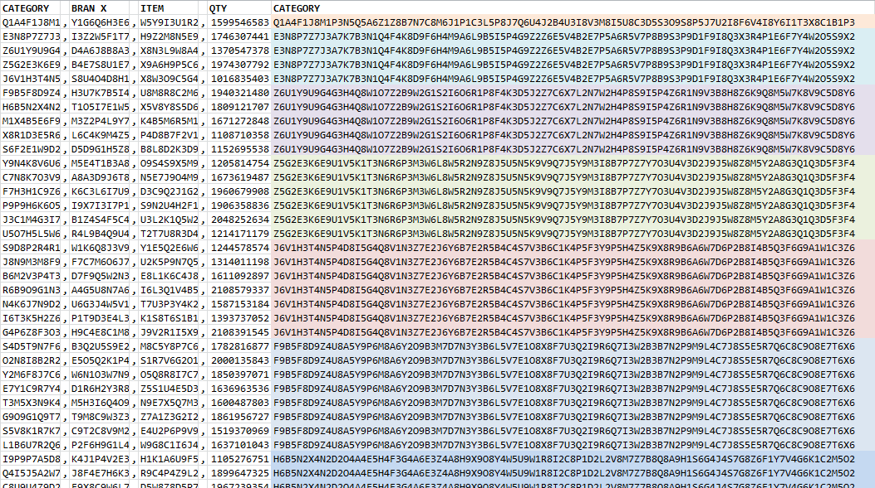
Simulation Data
Alpha-Numeric Data Set: CATEGORY – Incrementally duplicated data-points

Slide 9
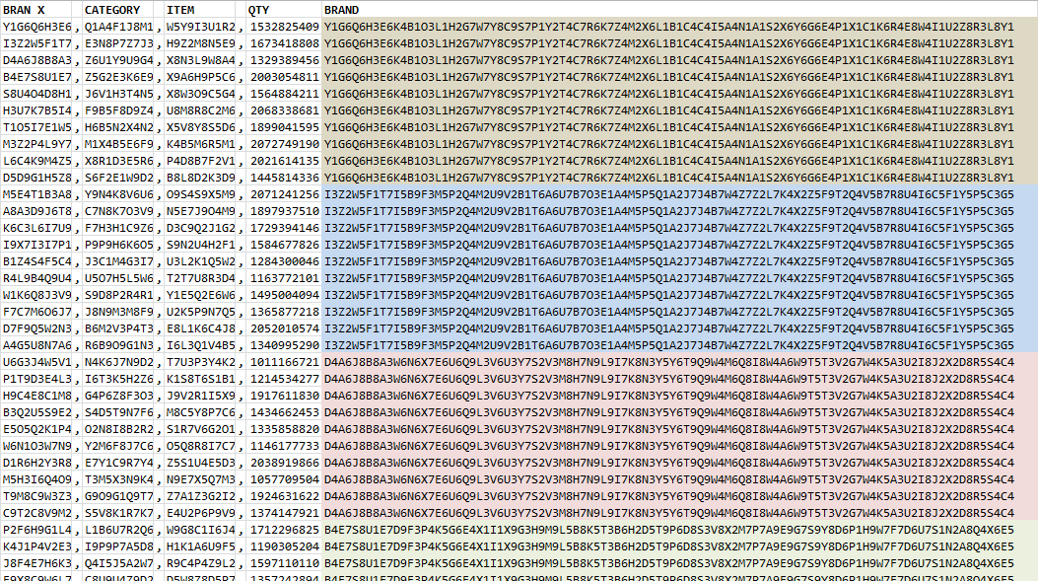
Simulation Data
Alpha-Numeric Data Set: BRAND – Fixed 10x Duplicated data-points

Slide 10
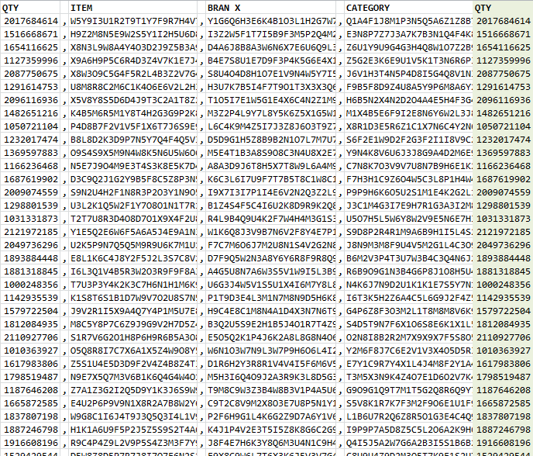
Simulation Data
Numeric Data Set: QUANTITY – Unique data-points

Slide 11

Data simulation flow
start
Set
Start Time
Perform
Quick Sort
Set
End Time
Add Sampling Result to List
data
Read Data
from File
Set
Start Time
Perform
Merge Sort
Set
End Time
Add Sampling Result to List
Sampling = 5
Initiate Sorting
No
Set
Start Time
Perform
Heap Sort
Set
End Time
Add Sampling Result to List
Set
Start Time
Perform Bubble Sort
Set
End Time
Add Sampling Result to List
Yes
Generate List
Data-Type,Sort-Col,Data-Pts,Algo1,..,Algo7
Data-Type,Sort-Col,Data-Pts,Algo1,..,Algo7
Data-Type,Sort-Col,Data-Pts,Algo1,..,Algo7
Data-Type,Sort-Col,Data-Pts,Algo1,..,Algo7
Data-Type,Sort-Col,Data-Pts,Algo1,..,Algo7
Set
Start Time
Perform Insertion Sort
Set
End Time
Add Sampling Result to List
Set
Start Time
Perform Selection Sort
Set
End Time
Add Sampling Result to List
Set
Start Time
Perform Radix Sort
Set
End Time
Add Sampling Result to List
Manually Collected to Excel

